Slide 1


Slide 2
Sales Analysis
Daily & Weekly Sales Insights
LINDELWA KHUMALO: October 2025

Slide 3
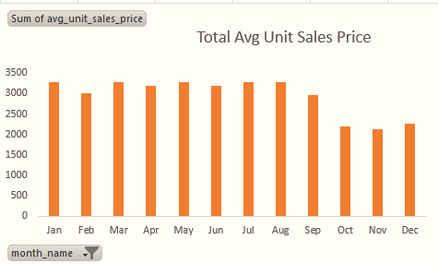
Sales Performance by Day
The average unit sales price remains consistently high from January through August.
There is a clear and significant drop in the average unit sales price starting in September.
We maintained excellent pricing strength, keeping our average unit sales price consistently above for eight straight months, from January through August. This speaks to the value perception of our products

Slide 4
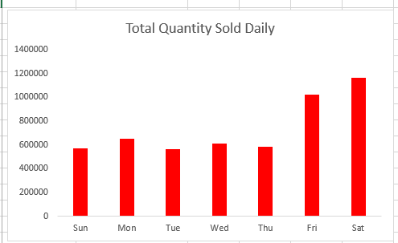
The highest quantities of units are sold on the weekend, with Saturday and Friday being the clear leaders.
Friday and Saturday drive our unit volume, accounting for over 35% of the total units sold in the week. This is critical for moving inventory and gaining market share.
We need to study what premium products are selling on Thursday and find a way to scale that volume without sacrificing the high price

Slide 5
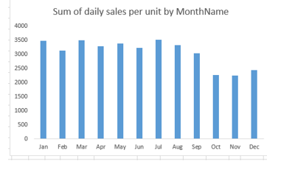
Sum of Daily per unit by Month
Peak Months: January, March, July, and August achieved the highest price points, nearing $3,500.
Insight: This eight-month period showcases the business's ability to command a premium price and maintain high margins.
The severe decline in the Average Unit Price did not generate enough compensating Total Sales Revenue, indicating that our promotional depth or product mix is deeply eroding profitability without maximizing sales volume.

Slide 6
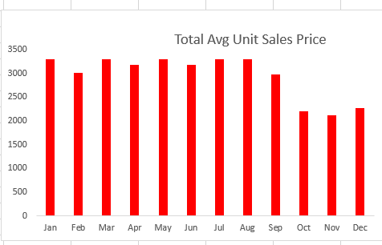
Total Avg Unit Sales Price per Month
The company maintained a very high and stable average unit sales price (AUSP) for the first three quarters (January through September)
This sustained high price point suggests strong brand loyalty, a premium product mix, or effective margin management for the majority of the year. This period is a model for pricing strategy.
This massive reduction strongly indicates a major shift in sales strategy, likely driven by heavy, sustained discounting (Black Friday/Holiday sales) or a massive spike in sales of low-cost, entry-level products.

Slide 7
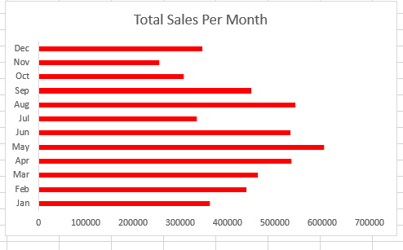
Total Sales Per Month
May is the month with the highest total sales and November is the month with the lowest total sales revenue by a considerable margin.
This five-month window drives a disproportionately high amount of the company's annual revenue. This indicates a strong seasonal peak, potentially related to specific product cycles, weather, or campaign timing.

Slide 8
Recommendations
Boost Low-Value Days (Mon-Tue):
Run targeted digital campaigns (social media, email) offering a "Monday-Tuesday Exclusive Value Item" or limited-time deal
Optimize "High-Volume" Days (Fri-Sat):
Introduce a Minimum Threshold for Free Shipping/Gift on Friday and Saturday.
Leverage "High-Price" Days (Mon-Thu):
Implement an Upselling and Cross-Selling Program specifically for Monday-Thursday sales teams.
Align Sales & Marketing:
Create unified goals and dashboards (KPIs) for both teams focused on Gross Margin, not just raw revenue or volume. The marketing team must understand the profit sensitivity of their promotions.
Invest in Customer Loyalty:
Strengthen relationships with high-spending customers (the 20% who provide 80% of profit). Offer them early access or exclusive pricing instead of public discounts.
Profit-Focused Promotions:
Shift from deep, flat discounts (e.g., "50% Off Everything") to Value-Based Bundling and Tiered Rewards.

Slide 9
THE END THANK YOU

